Slide 1

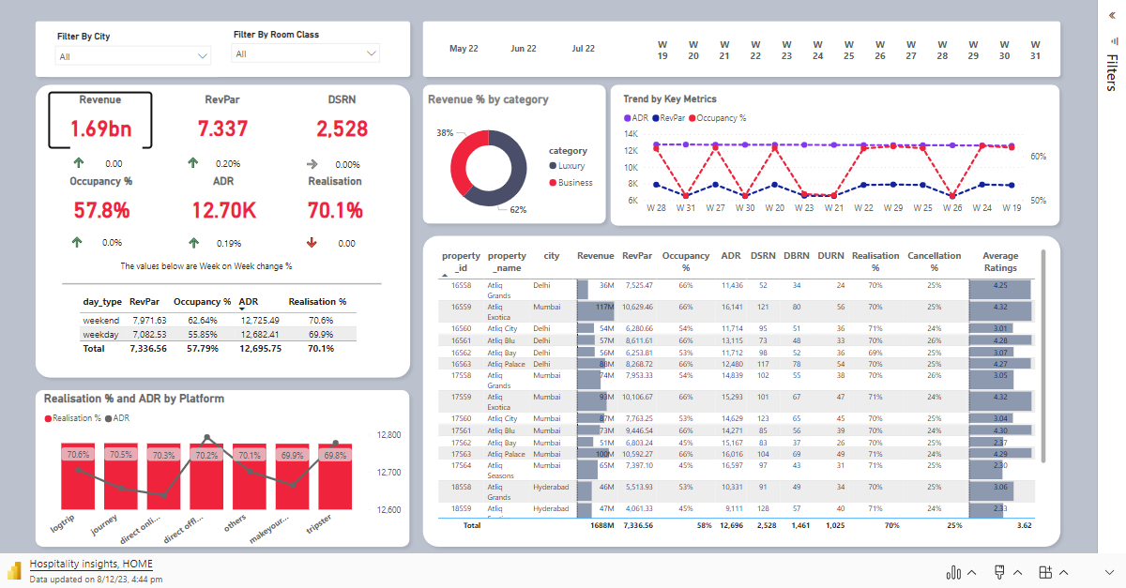
Revenue Insights-Hospitality domain

